Slide 1
9 Databases
Database introduction

Slide 2

What is a database?
Databases are structured, persistent collections of data.
They allow us to arrange and store data in a series of tables for further querying and manipulation.

Slide 3
Types of databases
Flat-file
Covered in IGCSE
Relational
Beyond the syllabus
What is a database?

Slide 4
Flat-file database
A flat-file database consists of one or more tables.
ClientsTbl
ID | Customer | Country | City | Date | Renew
1 | Dongford International | USA | New York | 13.09.2018 | Y
2 | Stateford Co. | France | Paris | 14.11.2000 | Y
3 | Standard Ltd. | USA | San Francisco | 21.03.2007 | N
4 | Nardis | Japan | Tokyo | 30.05.2012 | Y
5 | Together Ltd. | USA | New York | 01.04.1998 | N
6 | Nori | Japan | Tokyo | 07.07.2005 | Y
7 | Intersec Co. | Germany | Berlin | 15.11.2020 | Y

Slide 5
Flat-file database
A flat-file database consists of one or more tables.
Each table consists of many separate records (rows). Records are identical in structure, though their contents will vary.
ClientsTbl
ID | Customer | Country | City | Date | Renew
1 | Dongford International | USA | New York | 13.09.2018 | Y
2 | Stateford Co. | France | Paris | 14.11.2000 | Y
3 | Standard Ltd. | USA | San Francisco | 21.03.2007 | N
4 | Nardis | Japan | Tokyo | 30.05.2012 | Y
5 | Together Ltd. | USA | New York | 01.04.1998 | N
6 | Nori | Japan | Tokyo | 07.07.2005 | Y
7 | Intersec Co. | Germany | Berlin | 15.11.2020 | Y

Slide 6
Flat-file database
A flat-file database consists of one or more tables.
Each table consists of many separate records (rows). Records are identical in structure, though their contents will vary.
Each record consists of a number of separate fields (columns).
ClientsTbl
ID | Customer | Country | City | Date | Renew
1 | Dongford International | USA | New York | 13.09.2018 | Y
2 | Stateford Co. | France | Paris | 14.11.2000 | Y
3 | Standard Ltd. | USA | San Francisco | 21.03.2007 | N
4 | Nardis | Japan | Tokyo | 30.05.2012 | Y
5 | Together Ltd. | USA | New York | 01.04.1998 | N
6 | Nori | Japan | Tokyo | 07.07.2005 | Y
7 | Intersec Co. | Germany | Berlin | 15.11.2020 | Y

Slide 7
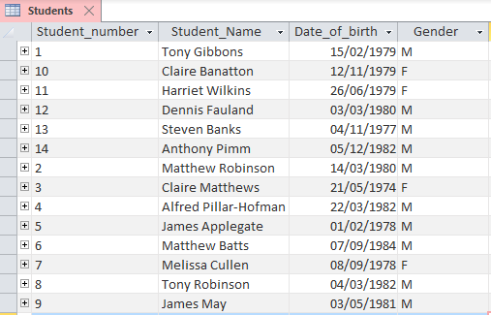
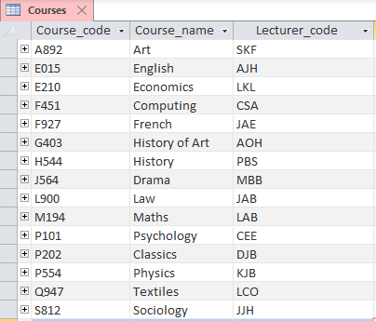
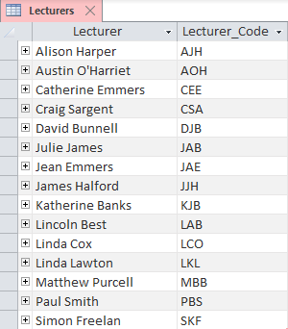

Relational database
A relational database consists of multiple related tables.
In this example, changing the lecturer code for a course will update the associated field for all students on that course.
How separate database tables are linked together to create a relational database is beyond the scope of the IGCSE course. We have included it here for awareness, as it is something you are likely to come across should you continue to study computer science.

Slide 8
Databases
Each field in a database table has a defined field type – these include:
Text/alphanumeric
Character
Boolean
Integer
Real
Date/time
Integer | Text/alphanumeric | Text/alphanumeric | Text/alphanumeric | Date/time | Character
ID | Customer | Country | City | Date | Renew
1 | Dongford International | USA | New York | 13.09.2018 | Y
2 | Stateford Co. | France | Paris | 14.11.2000 | Y
3 | Standard Ltd. | USA | San Francisco | 21.03.2007 | N
4 | Nardis | Japan | Tokyo | 30.05.2012 | Y
5 | Together Ltd. | USA | New York | 01.04.1998 | N

Slide 9

Primary keys
With a database, we should make sure each record within a table is uniquely identifiable.
Consequently, at least one field in each record should be guaranteed to be unique – this field is known as the primary key.
ID | Customer | Country | City | Date | Renew
1 | Dongford International | USA | New York | 13.09.2018 | Y
2 | Stateford Co. | France | Paris | 14.11.2000 | Y
3 | Standard Ltd. | USA | San Francisco | 21.03.2007 | N
4 | Nardis | Japan | Tokyo | 30.05.2012 | Y
5 | Together Ltd. | USA | New York | 01.04.1998 | N
6 | Nori | Japan | Tokyo | 07.07.2005 | Y
7 | Intersec Co. | Germany | Berlin | 15.11.2020 | Y

Slide 10
Primary keys
While designing a table, you might discover one of the fields can act as a primary key.
In other situations, it will be necessary to create an additional field to act as the primary key.
 | First name | Surname | Age | Tutor group
 | Tony | Hilton | 14 | 10C
 | Amar | Aggarwal | 15 | 10E
 | Michael | Andrews | 14 | 10C
 | Claire | Smith | 15 | 10E
 | Nalini | Chahal | 15 | 10C
 | Chetan | Talwar | 14 | 10C
 | Andrew | Watts | 14 | 10C
 | Khasi | Vohra | 15 | 10B
 | James | Watkins | 15 | 10C
 | Sarah | Matthews | 15 | 10B
 | Tom | Nibblet | 15 | 10E
 | Mohandas | Majumdar | 14 | 10E
 | Andrew | Kuruvilla | 14 | 10B
Car_reg | Make | Model | Colour | Engine | Showroom
VK12 TKB | Vauxhall | Corsa | Red | 1.2 | Cars4U
K33 MAK | Audi | A1 | Green | 1.5 | Cars4U
1975 CS | Fiat | Panda | Black | 0.9 | DriveIT
MI76 HEL | BMW | i8 | Black | 1.5 | Need4Speed
BT32 UIK | Vauxhall | Carlton | Red | 1.8 | Cars4U
BL16 UDK | Mazda | Eunos 800 | White | 2.5 | Need4Speed
GH63KDM | Fiat | Freemont | Green | 1.2 | DriveIT
ST26VUL | Fiat | Ducato | Blue | 2.3 | Cars4U
BP38 YTE | Audi | TT | Black | 2.0 | Need4Speed
W77 NDX | Audi | Avant | White | 2.0 | DriveIT
5690 AR | Vauxhall | Crossland | Red | 1.2 | DriveIT
MAG 247H | BMW | X5 (G05) | Blue | 3.0 | Need4Speed
NV27 XAW | Fiat | Toro | Black | 2.4 | Cars4U
Student ID | First name | Surname | Age | Tutor group
0001 | Tony | Hilton | 14 | 10C
0002 | Amar | Aggarwal | 15 | 10E
0003 | Michael | Andrews | 14 | 10C
0004 | Claire | Smith | 15 | 10E
0005 | Nalini | Chahal | 15 | 10C
0006 | Chetan | Talwar | 14 | 10C
0007 | Andrew | Watts | 14 | 10C
0008 | Khasi | Vohra | 15 | 10B
0010 | James | Watkins | 15 | 10C
0011 | Sarah | Matthews | 15 | 10B
0012 | Tom | Nibblet | 15 | 10E
0013 | Mohandas | Majumdar | 14 | 10E
0014 | Andrew | Kuruvilla | 14 | 10B
Car_reg | Make | Model | Colour | Engine | Showroom
VK12 TKB | Vauxhall | Corsa | Red | 1.2 | Cars4U
K33 MAK | Audi | A1 | Green | 1.5 | Cars4U
1975 CS | Fiat | Panda | Black | 0.9 | DriveIT
MI76 HEL | BMW | i8 | Black | 1.5 | Need4Speed
BT32 UIK | Vauxhall | Carlton | Red | 1.8 | Cars4U
BL16 UDK | Mazda | Eunos 800 | White | 2.5 | Need4Speed
GH63KDM | Fiat | Freemont | Green | 1.2 | DriveIT
ST26VUL | Fiat | Ducato | Blue | 2.3 | Cars4U
BP38 YTE | Audi | TT | Black | 2.0 | Need4Speed
W77 NDX | Audi | Avant | White | 2.0 | DriveIT
5690 AR | Vauxhall | Crossland | Red | 1.2 | DriveIT
MAG 247H | BMW | X5 (G05) | Blue | 3.0 | Need4Speed
NV27 XAW | Fiat | Toro | Black | 2.4 | Cars4U

Slide 11

Databases validation
When a database table structure is first created, it can be assigned various validation rules.
Validation rules can be assigned to any field of a table – these include:
Length check
Format check
Range check
Presence check
Custom rule such as Apprentice, Expert or Master.
We discussed various validation methods in detail in the following video:
83. CAMBRIDGE IGCSE (0478-0984) 7 Validation

Slide 12

Single-table databases
Databases are structured, persistent collections of data.
Databases come in two forms – single-table, flat file databases and relational databases. You are only required to know about single-table databases.
Flat file databases
Consist of separate tables.
Each table is made up of a number of records.
Each record has a number of separate fields.
Fields can be one of several basic data types – text/alphanumeric, character, Boolean, integer, real, date/time.
Each table in a database should have a primary key. The primary key field must be a field that can uniquely identify each record in the table.
Database table fields can be assigned various validation rules – length check, format check, range check, presence check, custom rule, etc.

Slide 13


